Slide 1
Segmentation of brain tissues
Final Presentation MIALab
Matthias Fontanellaz, Michel Hayoz, Jonas Ledergerber
19.12.2018, ISTB Uni Bern
Notes:
<number>

Slide 2
Content
Clinical Problem
Goals
Setup
Methods
Results / Discussion
Conclusion
19.12.2018
Segmentation of brain tissues
<number>
Notes:
<number>

Slide 3
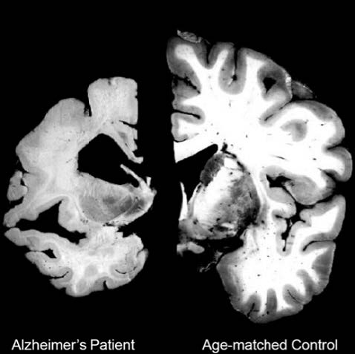
Clinical Problem
Neurodegenerative diseases: Alzheimer, Parkinson, …
High clinical need
Numbers to increase
Degree and progression of the disease (Alzheimer)
Atrophy of the brain
Segmentation of brain tissues in MRI images
Manual segmentation not viable
Machine Learning approach
19.12.2018
Segmentation of brain tissues
<number>
Notes:
Neurodegenerative diseases of the central nervous system are still one of the greatest areas of unmet clinical need in the world [1].
Neurodegenerative diseases like Alzheimer, Parkinson, ALS or Huntingdon’s disease affect mostly elderly people.
For example only 2 percent of all dementia cases start before the age of 65 years.
As the older adult population in developed countries will increase, neurodegenerative diseases are predicted to increase as well leading to high costs for the care of these people [2].
!!!CLICK!!!
Because of the expected increase in need for segmentation, a manual segmentation is not any longer viable due to large amount of time needed.
<number>

Slide 4
Goals
Understand differences and advantages of different machine learning approaches on segmenting brain tissues.
Interpret individual feature importance and their influence on segmentation quality.
19.12.2018
Segmentation of brain tissues
<number>
Notes:
<number>

Slide 5
Setup
Data
100 unrelated healthy subjects – Human Connectome Project preprocessed data set (skull stripped, bias field corrected, registered, …)
Pipeline – Supervised Machine Learning
Training on training data (70 ground truth images)
Testing on testing data (30 unseen images)
Usually testing on less images
19.12.2018
Segmentation of brain tissues
<number>
Notes:
The image analysis pipeline used is the MIALab Pipeline v2018 [4] from previous work at the ISTB Bern.
<number>

Slide 6
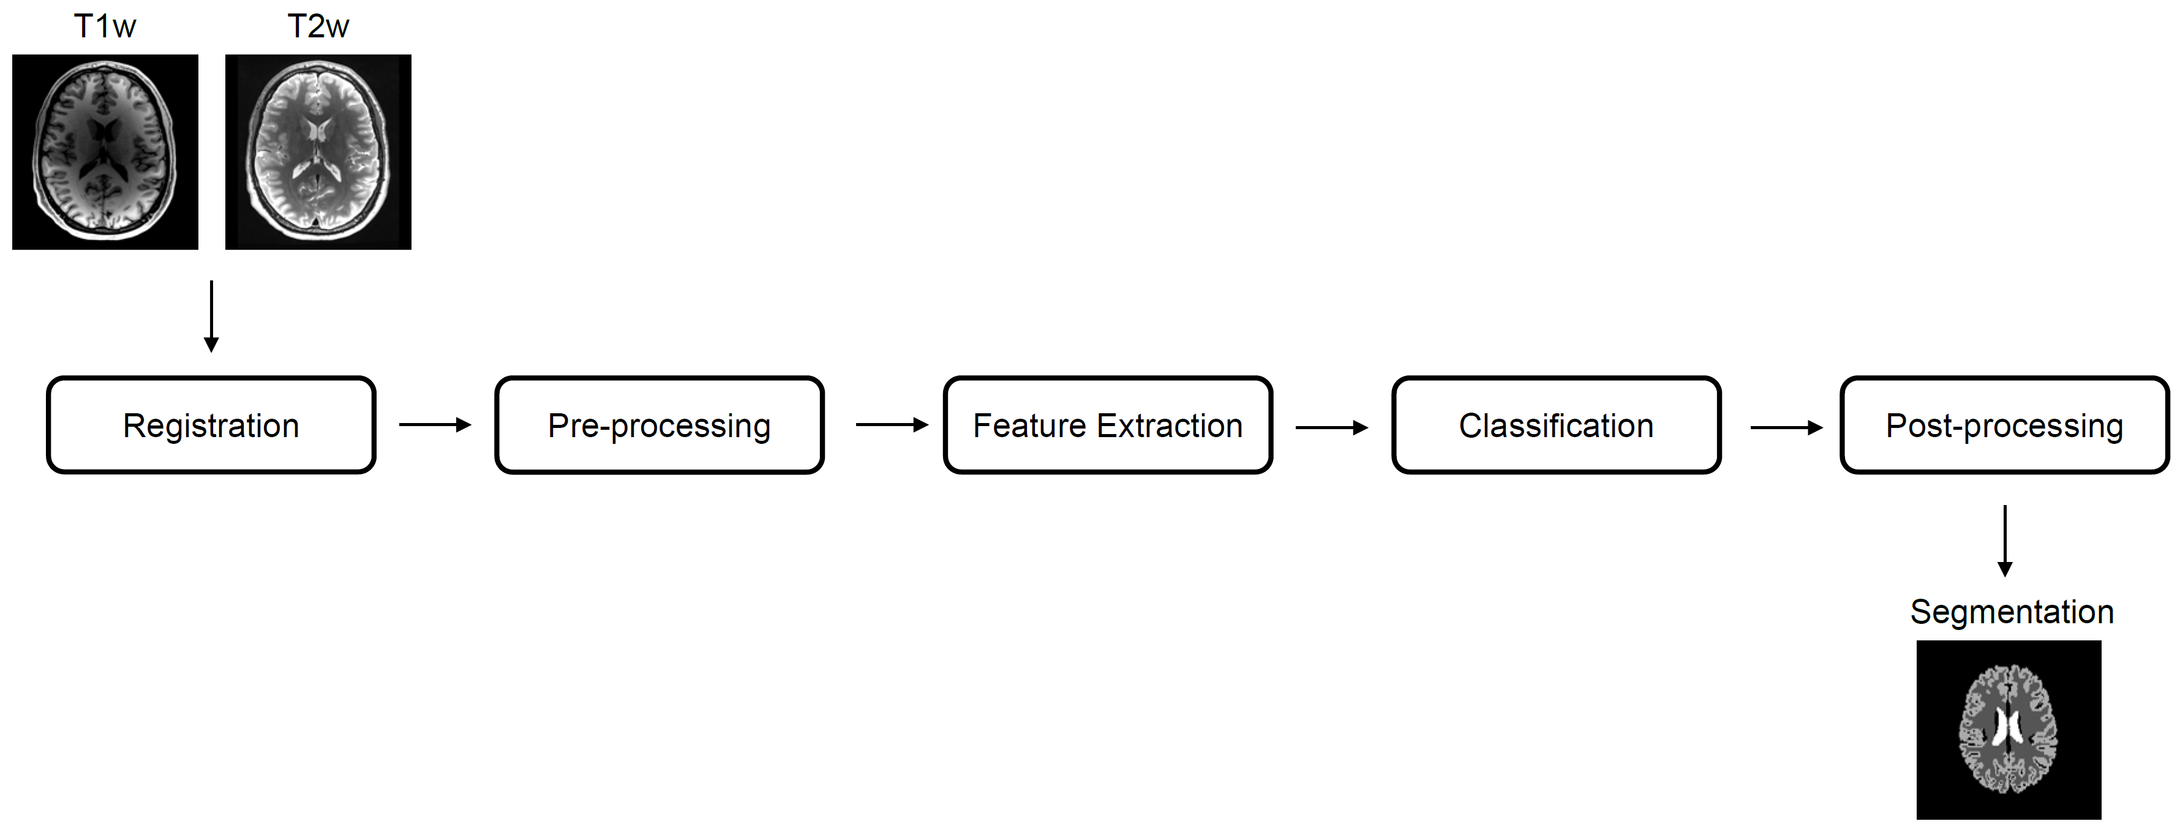
Notes:
The original pipeline uses a random forest tree approach for classification, that includes a training-cycle with a total of 100 ground truth images and 100’000 samples for background, grey and white matter as well as roughly 25’000 samples for hippocampus, amygdala and thalamus.
The following features were used in the basic pipeline: T1 and T2 intensities and gradient magnitude, x, y, z coordinates.
Our project focused on the classification part and we introduced different methods to assess differences in methods and parameters.
<number>

Slide 7
Methods
Evaluate different methods for segmentation
Random forest
Logistic regression
SVM linear
SVM linear polynomial features (x², y², z²)
SVM rbf
Approach
Balance training samples per class
Adjust training samples with respect to training images
Investigate ground-truth variance
Evaluate different metrics
19.12.2018
Segmentation of brain tissues
<number>
Notes:
Approaches:
7 original features + polynomial features (position -> x^2, xy, xz, yz, y^2, z^2) mapping the input into high-dimensional feature spaces to perform non-linear classification
Parameter tuning (GridSearch for C where applicable)
Balance of training examples per class (smaller structures are relatively more taken into account)
Feature scaling
<number>

Slide 8
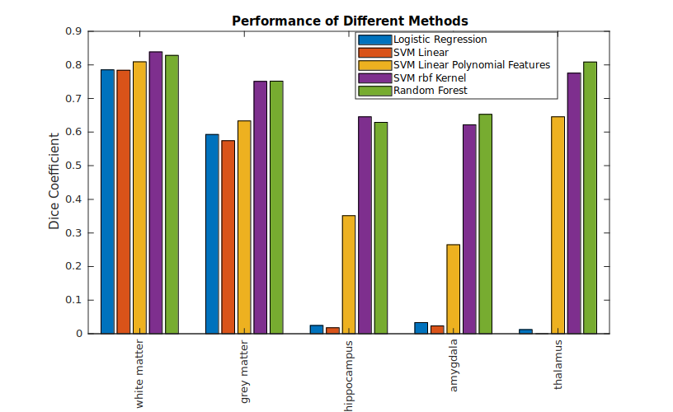
Results / Discussion
19.12.2018
Segmentation of brain tissues
<number>

Slide 9
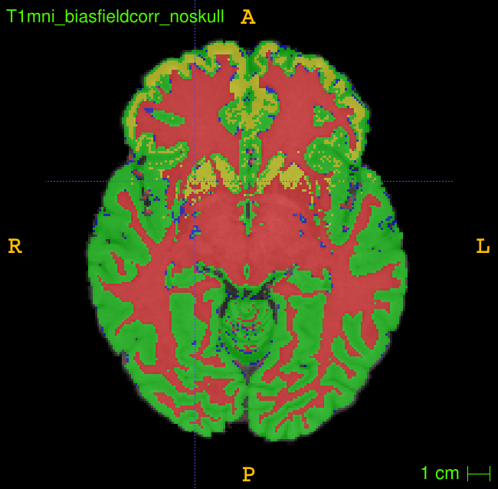
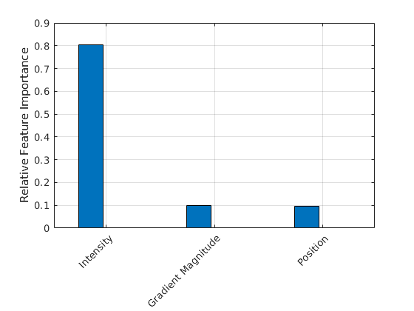
Insights SVM (linear)
Linear Position Features cannot capture shape
19.12.2018
Segmentation of brain tissues
<number>

Slide 10
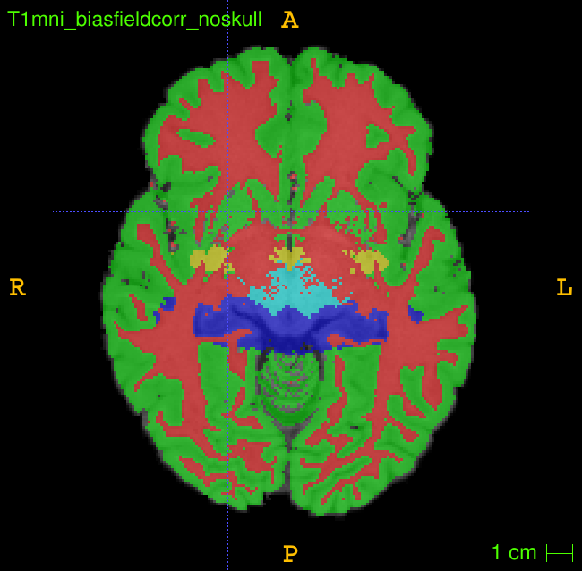
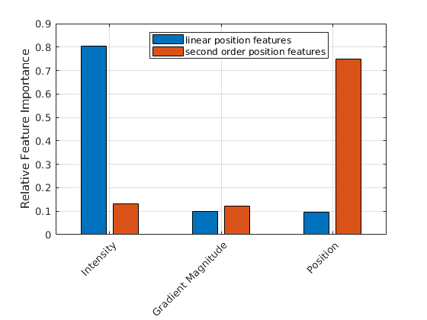
Insights SVM (linear)
Second order position features → ellipsoids
19.12.2018
Segmentation of brain tissues
<number>

Slide 11
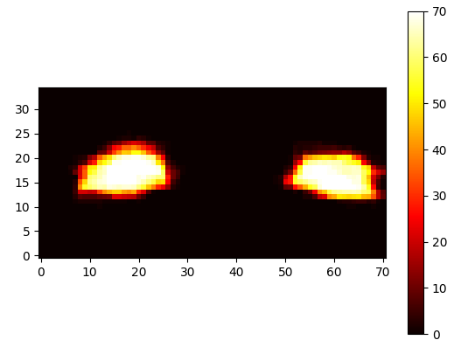
Insights SVM (linear)
Sum of ground-truth over training samples (Amygdala)
Very low variance
19.12.2018
Segmentation of brain tissues
<number>

Slide 12
Insights SVM (rbf)
Parameter used to tune the algorithm
Slackness C
Kernel width gamma = 5
Optimal parameter set: C = 15, gamma = 5
Assessing feature importance is more complex
Optimizing dual form
Visual methods
Sensitivity and Specificity to asses segmentation results
19.12.2018
Segmentation of brain tissues
<number>

Slide 13
Insights SVM (rbf)
Sensitivity (true positive rate)
Indicates correctly segmented voxels
Reduced in case of under-segmentation
=TP/(TP+FN)
Specificity (true negative rate)
Indicates correctly rejected voxels
Reduced in case of over-segmentation
=TN/(TN+FP)
19.12.2018
Segmentation of brain tissues
<number>

Slide 14
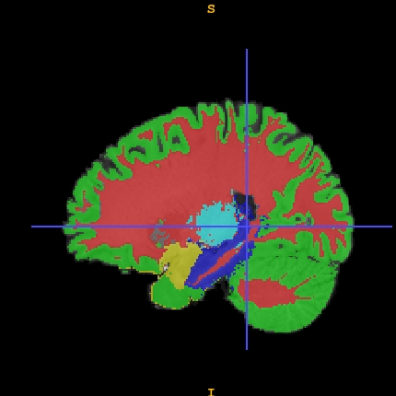
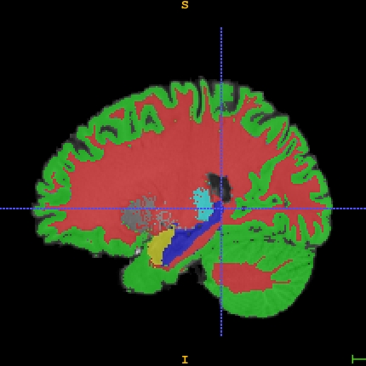
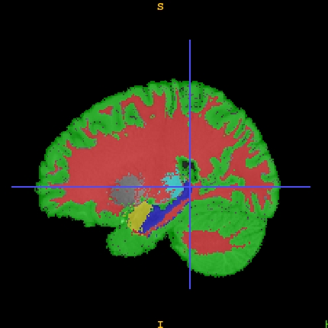
Insights SVM (rbf)
C=1, G=0.3
For Hippocampus
Dice: 0.3715
Sensitivity: 0.9583
Specificity: 0.9955
Random Forest
For Hippocampus
Dice: 0.6288
Sensitivity: 0.971
Specificity: 0.9984
C=15, G=10
For Hippocampus
Dice: 0.6781
Sensitivity: 0.9179
Specificity: 0.9989
19.12.2018
Segmentation of brain tissues
<number>

Slide 15
Insights SVM (rbf)
C=1, G=0.3
For Grey Matter
Dice: 0.7221
Sensitivity: 0.9658
Specificity: 0.9426
Random Forest
For Grey Matter
Dice: 0.7517
Sensitivity: 0.9638
Specificity: 0.9514
C=15, G=10
For Grey Matter
Dice: 0.7511
Sensitivity: 0.9463
Specificity: 0.9087
19.12.2018
Segmentation of brain tissues
<number>

Slide 16
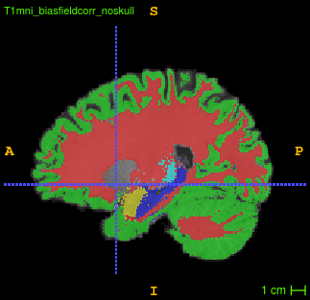
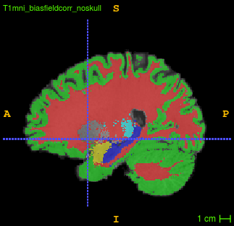
Insights SVM (rbf)
C=15, G=5, reduced training set with increased data points per patient
C=15, G=5, full training set with less data points per patient
19.12.2018
Segmentation of brain tissues
<number>

Slide 17
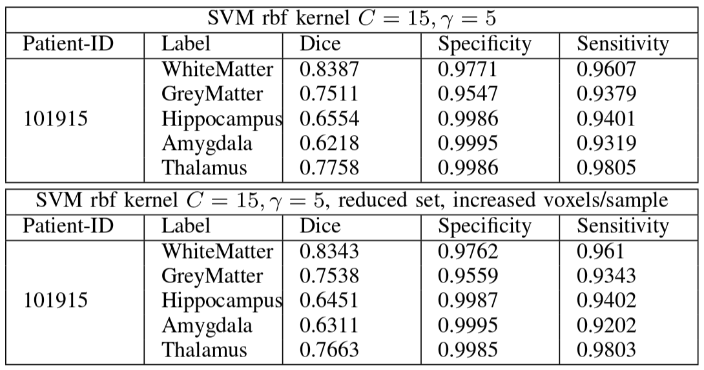
Insights SVM (rbf)
19.12.2018
Segmentation of brain tissues
<number>

Slide 18
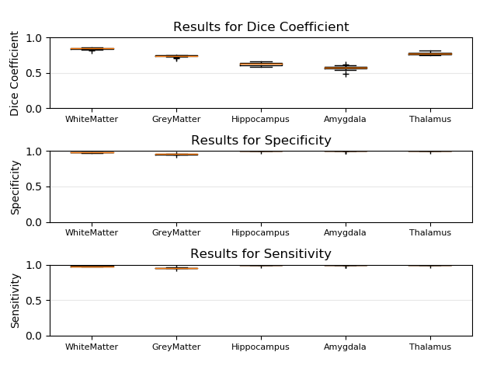
Insights SVM (rbf)
19.12.2018
Segmentation of brain tissues
<number>

Slide 19
Conclusion
SVM with linear kernel struggles in capturing complex shapes
Overall segmentation quality is best with an SVM rbf kernel; comparable to random forest.
Balancing out training samples per class and reducing training subjects by simultaneously increasing the samples per subject did not change the performance due to well registered and consistent data
Sensitivity and specificity can be used to asses over- and under-segmentation
19.12.2018
Segmentation of brain tissues
<number>

